Slide 1
MANAKULA VINAYAGAR INSTITUTE OF TECHNOLOGY PUDUCHERRY-605107
IOT BASED SMART FARMING SYSTEM
B.Tech CSE(ICB)
Presented by
S.HARISH
S.BALAMURALIKRISHNA
S.PRIYADARSHAN
Project guide
MR.PALANIVEL

Slide 2
OUTLINE OF THE PRESENTATION
OBJECTIVES
INTRODUCTION
LITERATURE REVIEW
METHODOLOGY
SENSORS & POWER SUPPLY
CIRCUIT DESCRIPTION & WORKING PRINCIPAL
ALGORITHMS
CONCLUSIONS
FUTURE SCOPE
REFERENCES

Slide 3
OBJECTIVES
This project is help to farmer into day to day life.
And its implement in large and small scale farming a land

Slide 4
INTRODUCTION
This system is proved Automatic irrigation by using moisture sensor and Temperature sensor also indicated moister level in soil as show in data.
This system is can use in different plants and different plants system also use this system.
Crop automatic water circulated by detection moister level in soil to measure and controlled by IoT(Internet of Things) system.

Slide 5
LITERATURE REVIEW
SMART FARMING
Historically, ancient agriculture practices were related to the production of food in cultivated lands for the survival of humans and the breeding of animals, and was called the traditional agricultural .
INTERNET OF THINGS
The Internet of Things (IoT) is a new technology that allows devices to connect remotely to achieve smart farming.
The IoT has begun to influence a vast range of industries, from health, trade, communications, energy and agriculture, to enhance efficiency and performance across all markets.

Slide 6
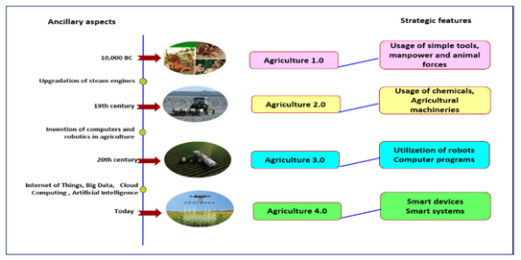
Fig:1

Slide 7
METHODOLOGY
DEFINITION IOT BASED SMART FARMING SYSTEM
IoT based SMART FARMING SYSTEM is regarded as IoT gadget focusing on Live Monitoring of Environmental data in terms of Temperature, Moisture and other types depending on the sensors integrated with it.
The system provides the concept of “Plug & Sense” in which farmers can directly implement smart farming by as such putting the System on the field and getting Live Data feeds on various devices like Smart Phones, Tablets etc

Slide 8
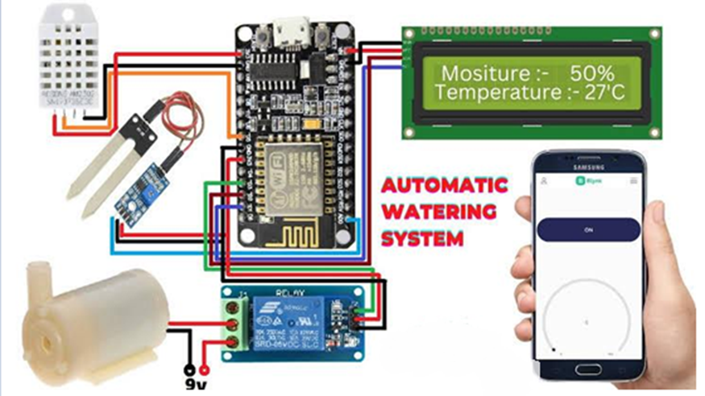
DEFINITION IOT BASED SMART FARMING SYSTEM
Fig:2

Slide 9
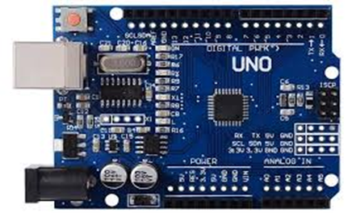
ARDUINO UNO
The Arduino Uno is a microcontroller board based on the ATmega328(datasheet). It has 14 digital input/output pins (of which 6 can be used as PWM outputs),6 analogy inputs, a 16 MHz crystal oscillator, a USB connection, a power jack, an ICSP header, and a reset button.
Fig:3

Slide 10
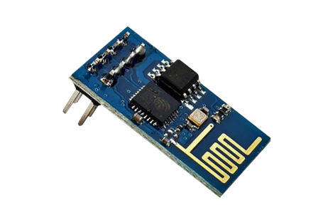
WIFI MODULE-ESP 8266
ESP8266 Wi-Fi Module is SOC with TCP/IP protocol stack integrated which facilitates any microcontroller to access Wi-Fi network. ESP8266 module is cost effective module and supports APSD for VOIP Applications and Bluetooth co-existence interfaces.
Technical Specifications: 802.11b/g/n; Wi-Fi Direct, 1MB Flash Memory, SDIO 1.1/2.0, SPI, UART, Standby Power Consumption of <1.0mW.
Fig:4

Slide 11
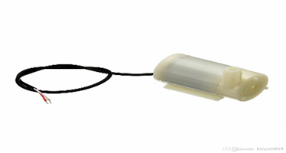
WATER PUMP
Motor drive use to the rotation directions of motors are controlled by Motor Control Pin.
The IN1 and IN2 are controlling Motor 1 while IN3 and IN4 are controlling Motor 2. Beside motor rotate direction, this Motor Driver Module is able to control motors' speed as well by Motor PWM Control Pin.
Water Pump motor is used to supply water to field.
Fig:5

Slide 12
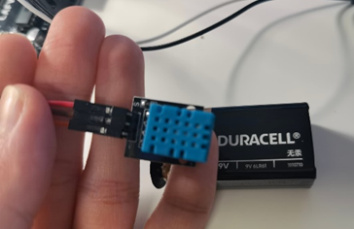
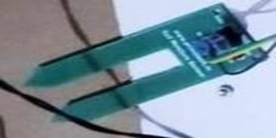
SENSORS
Fig:6 TEMPERATURE SENSOR-DHT11
Fig: 7 SOIL MOISTURE SENSOR-FC 28

Slide 13
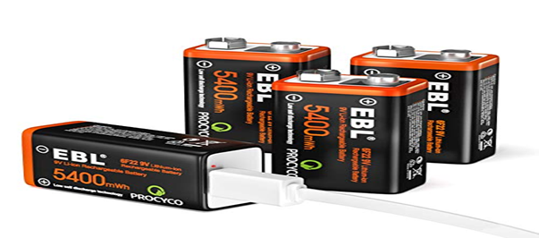
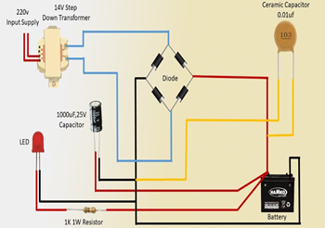
POWER SUPPLY
Fig:8 RECHARGEABLE BATTERY
Fig:9 BATTERY CHARGING CIRCUIT WITH TRANSFORMER

Slide 14
CIRCUIT DESCRIPTION & WORKING PRINCIPAL
In this circuit there is a programmed ARDUINO which is connected with sensors (soil moisture and temperature) and a wifi module. The working principal of the model based on storing data from the sensors with the help of ARDUINO and passing it to wife module.
There is also charging circuit with AC/DC converter for charging battery. In the case if the battery is not charged there further an adaptor which can explicitly gives power to ARDUINO circuits.

Slide 15
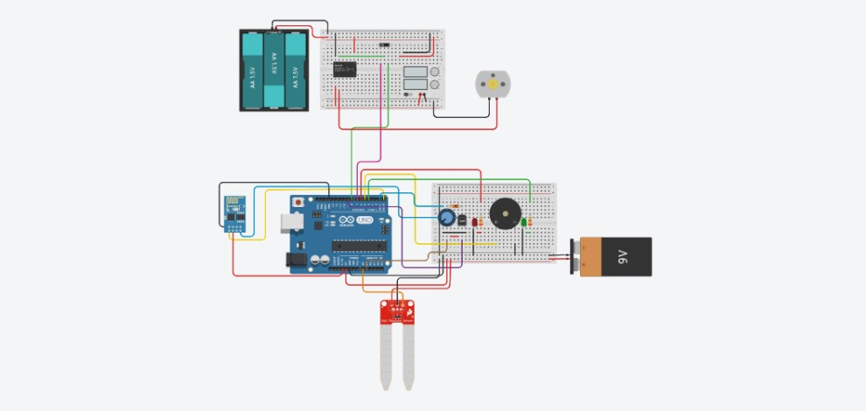
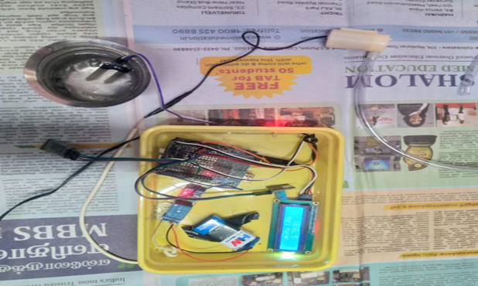
CIRCUIT DESCRIPTION & WORKING PRINCIPAL
Fig:10 CIRCUIT DESCRIPTION & WORKING PRINCIPAL

Slide 16
ALGORITHMS
THE ALGORITHM OF OVERALL PROCESS: -
STEP 1: START THE PROCESS
STEP 2: CONNECTED TO BLUETOOTH
STEP 3: READ TEMERATURE AND HUMIDITY
STEP 4: GET TEMPERATURE AND HUMIDITY VALUE S FROM ANOLOG PINS
STEP 5: SEND DATA TO APPLICATION
STEP 6: DELAY TO 10 SECONDS
STEP 7: REPEAT STEP 4, 5 & 6 UNTIL THE PROCESS END
STEP 8: END

Slide 17
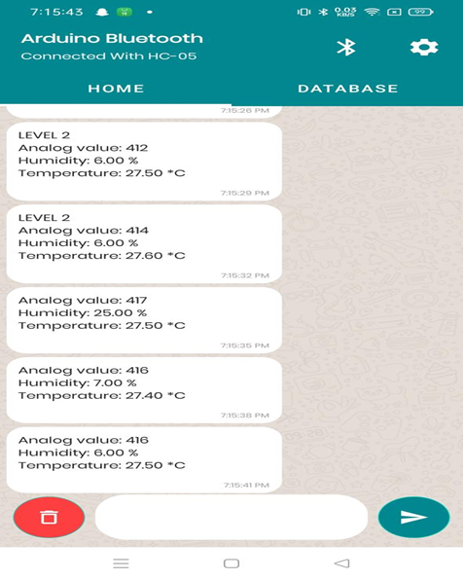
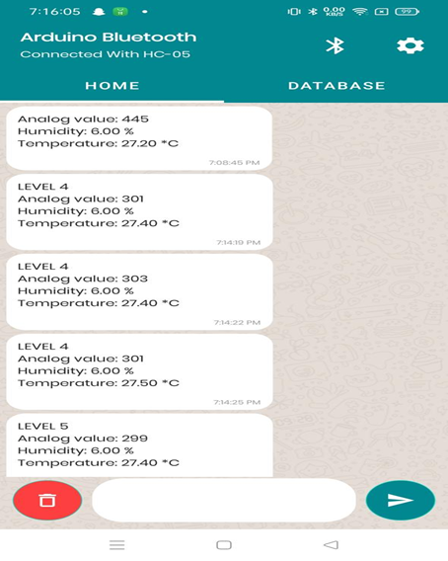
OUTPUT GRAPHS
Fig: 11. Live Data of Temperature with Date and Time

Slide 18
CONCLUSION
IoT based SMART FARMING SYSTEM for Live Monitoring of Temperature and Soil Moisture has been proposed using Arduino and Cloud Computing.
The System has high efficiency and accuracy in fetching the live data of temperature and soil moisture.
The IoT based smart farming System being proposed via this report will assist farmers in increasing the agriculture yield and take efficient care of food production as the System will always provide helping hand to farmers for getting accurate live feed of environmental temperature and soil moisture with more than 99% accurate results.

Slide 19
FUTURE SCOPE
Future work would be focused more on increasing sensors on this system to fetch more data especially with regard to Pest Control and by also integrating GPS module in this system to enhance this Agriculture IoT Technology to full-fledged Agriculture Precision ready product.

Slide 20
REFERENCES
Raj Kumar, G.; Chandra Shekhar, Y.; Shweta, V.; Ritesh, R. Smart agriculture—Urgent need of the day in developing countries. Sustain. Compute. Inform. Syst. 2021, 30, 100512. [Google Scholar]
El Nahry, A.H.; Mohamed, E.S. Potentiality of land and water resources in African Sahara: A case study of south Egypt. Environ. Earth Sci. 2011, 63, 1263–1275. [Google Scholar] [Crossruff]
Palombi, L.; Sessa, R. Climate-Smart Agriculture: Source Book; Food and Agriculture Organization: Rome, Italy, 2013. [Google Scholar]
Adamides, G.; Kalatzis, N.; Stylianou, A.; Mariano’s, N.; Chatzipapadopoulos, F.; Giannakopoulou, M.; Papadavid, G.; Vassiliou, V.; Neocleous, D. Smart Farming Techniques for Climate Change Adaptation in Cyprus. Atmosphere 2020, 11, 557. [Google Scholar] [CrossRef]
Patil, K.A.; Kale, N.R. A model for smart agriculture using IoT. In Proceedings of the 2016 International Conference on Global Trends in Signal Processing, Information Computing and Communication, Jalgaon, India, 22–24 December 2016; IEEE: Jalgaon, India, 2016; pp. 543–545. [Google Scholar]

Slide 21


